Slide 1
Intermolecular forces
11 Chemistry Unit 2

Slide 2
Learning goals
Explain the relationship between vapour pressure, melting point, boiling point and solubility, and the nature and strength of intermolecular forces (e.g. dispersion forces, dipole-dipole attractions, and hydrogen bonding) within molecular covalent substances.

Slide 3
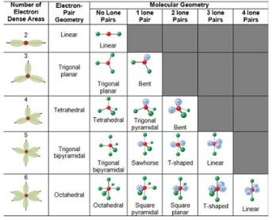

Recap
Hint:
Draw the electron configuration of the ‘central’ atom, and see how many lone pairs there are!
1. Predict the geometry of the following compounds:
NH₃
SH₂
MgCl₂
SiH₄
2. Identify which of the above compounds are polar.

Slide 4
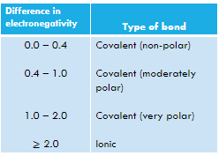
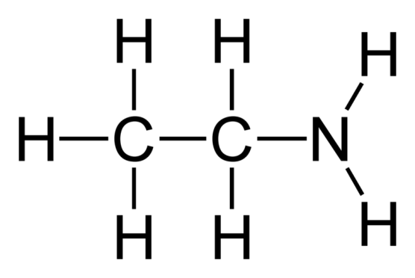
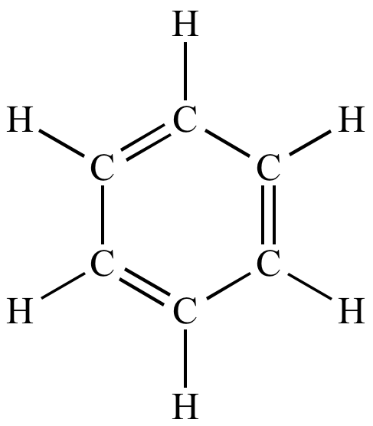
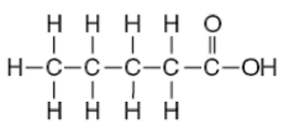
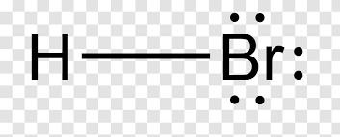
Recap – polar / non-polar
On each compound below, circle the polar and non-polar sections. For any polar sections, label the positive and negative poles.

Slide 5
Vocab List
Dispersion
London
Dipole
Polar
Hydrogen Bonding
Intramolecular
Intermolecular
Electrostatic
Dissolve
Solvent
Serenity
Hippopotamus

Slide 6
Intermolecular Forces (Why we care about polar bears)
Attractions between molecules
Weaker than intramolecular forces (ionic/covalent/metallic bonds)
Responsible for states of matter of a compound (gas, liquid or solid)
Strong intermolecular forces = molecules are held closer together
Types of intermolecular forces:
Dispersion forces
Dipole interactions
Hydrogen bonding

Slide 7
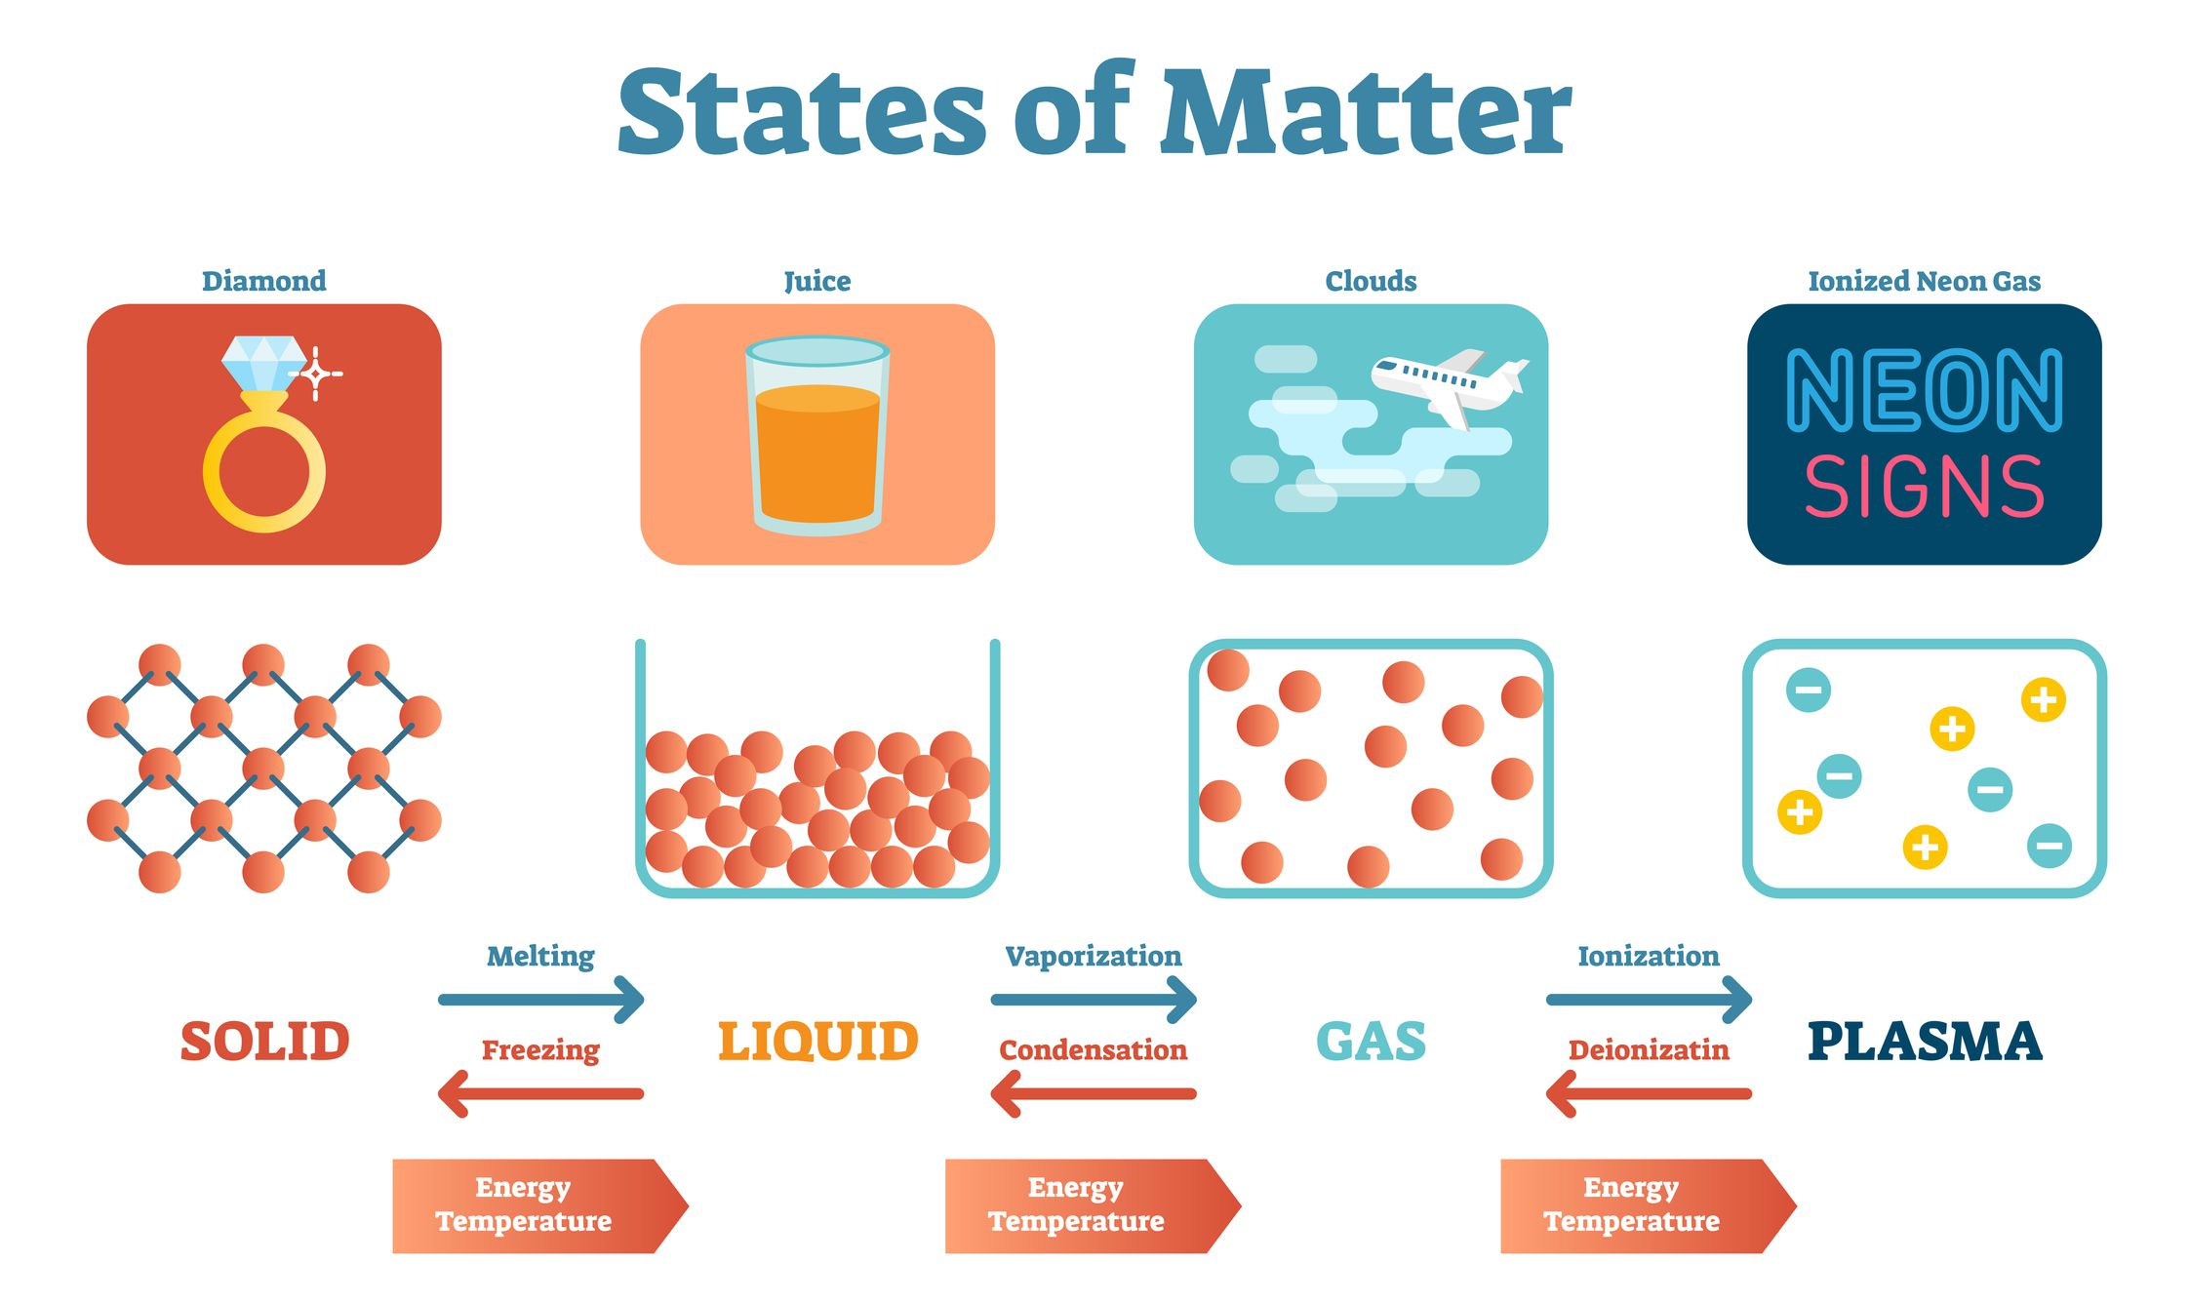

Slide 8
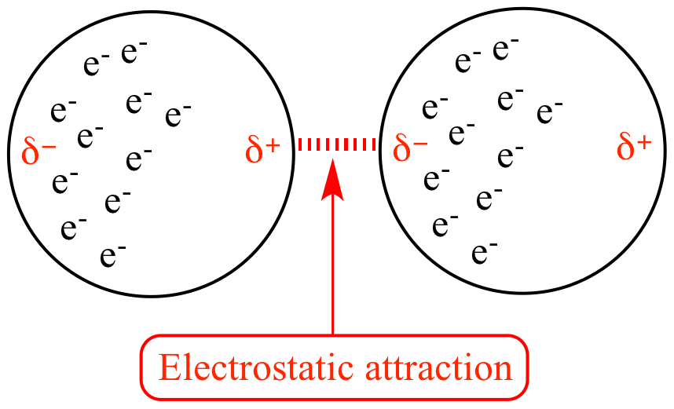
Dispersion Forces
Electron movements cause momentary dipoles within a molecule
These don’t last very long, leading to an attraction/repulsion yo-yo
Dispersion forces are always present.
This is caused by a dipole moment
Notes:
the nuclei in one molecule may attract the electrons in a second molecule, thus inducing an instantaneous dipole in the second molecule. In turn, the second molecule induces a dipole in the first. Thus, two non-polar molecules can interact as if there were dipole-dipole attractions between them, with positive and negative charges interacting and attracting. The tendency of a molecule to have an induced dipole is called the polarizability of the molecule. The more charged particles there are in a molecule, the more polarizable a molecule is and the greater the attractions arising from dispersion forces will be. A dipole moment is fairly self explanatory – as electrons whiz around the nucleus, there will be times when they are “loaded” on one side, leading to a brief dipole in the atom/molecule. The more often these moments occur, the stronger the intermolecular bond.

Slide 9
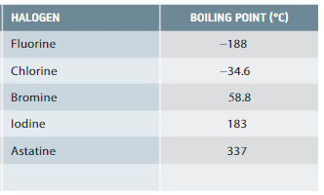
Your turn
1. Identify the trends in the data
2. Evaluate the statement “The strength of dispersion forces decrease as the number of electrons increase”, using the data to support your answer.

Slide 10
Dispersion Forces
Electron movements cause momentary dipoles within a molecule
These don’t last very long, leading to an attraction/repulsion yo-yo
Strength of dispersion forces increases as the number of electrons increases (more protons to attract more electrons).
E.G. He has a boiling point of 4 K
Xe has a boiling point of 165 K
Dispersion forces are always present.
This is caused by a dipole moment
Notes:
the nuclei in one molecule may attract the electrons in a second molecule, thus inducing an instantaneous dipole in the second molecule. In turn, the second molecule induces a dipole in the first. Thus, two non-polar molecules can interact as if there were dipole-dipole attractions between them, with positive and negative charges interacting and attracting. The tendency of a molecule to have an induced dipole is called the polarizability of the molecule. The more charged particles there are in a molecule, the more polarizable a molecule is and the greater the attractions arising from dispersion forces will be. A dipole moment is fairly self explanatory – as electrons whiz around the nucleus, there will be times when they are “loaded” on one side, leading to a brief dipole in the atom/molecule. The more often these moments occur, the stronger the intermolecular bond.

Slide 11
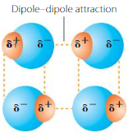


Dipole-Dipole Interactions
Occur when polar molecules are attracted to one another, lining up so that the positive pole of one molecule attracts the negative pole of another. This holds the molecule together by electrostatic forces.

Slide 12
Dipole-Dipole Interactions
+
+
-
+
-
-
-
-
_
+
+
+
+
+
+
-
-
-

Slide 13
Dipole-Dipole interactions
Example: HCl
Example: Ar
18 electrons
A polar molecule
Has dispersion forces acting
Has dipole-dipole interactions
Therefore has a stronger overall intermolecular force
BP of -83.7ºC
18 electrons
Nonpolar molecule
Has dispersion forces acting
No dipole-dipole interactions
BP of -186ºC

Slide 14
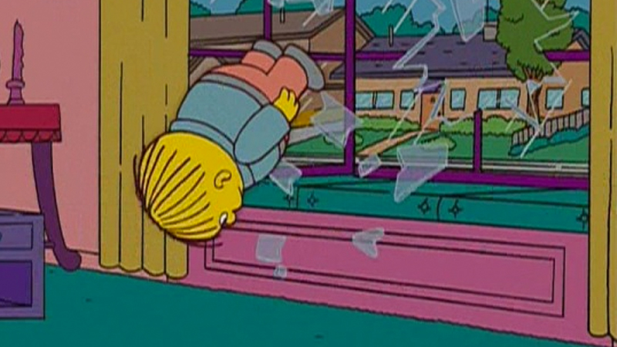
Hydrogen bonding
A special case of dipole-dipole attraction
A Hydrogen bond is a type of intermolecular force that involves a hydrogen atom bonded to an O, N or F atom in one molecule becoming attracted to an O, N or F in another molecule.
H bonds are stronger than ordinary dipole-dipole forces, as H nucleus is extremely small and F, O and N very electronegative.
Essentially just a super-strong version of dipole-dipole, in which H is involved

Slide 15
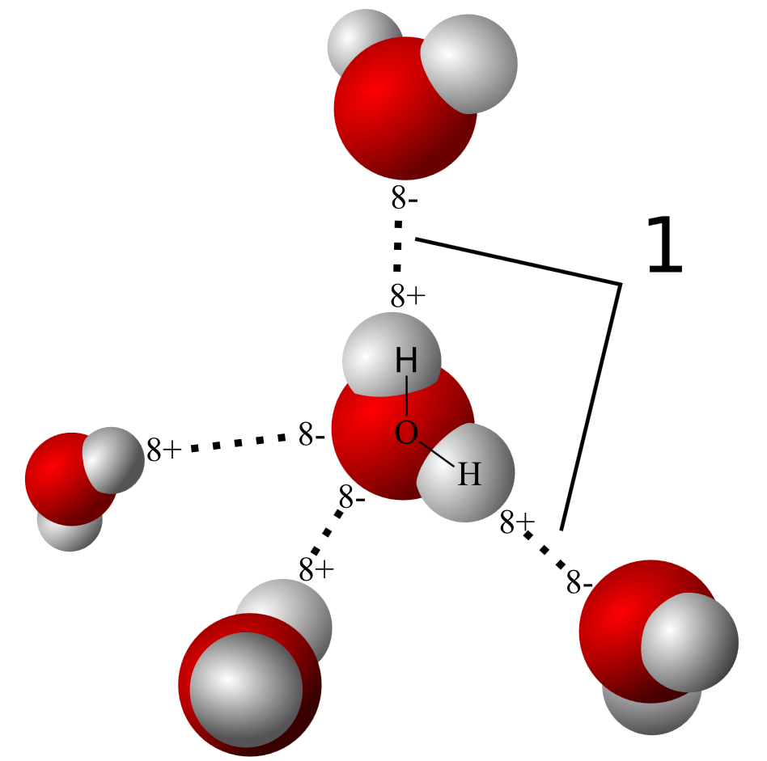
Hydrogen Bonding
H bonds to a more electronegative atom (N, O or F) → electrons move slightly toward that atom
H nucleus is exposed or unshielded (dipole is formed)

Slide 16
Hydrogen bonding
δ+
H
δ+
H
Negative F end can approach more closely to positive H end → a stronger bond
δ-
F
δ-
F
δ+
H
δ+
H
δ-
F
δ-
F

Slide 17
Hydrogen bonding
Important in determining the properties of water and biological molecules like proteins.
H bonding between water molecules results in:
The relatively higher melting and boiling points of water compared with other substances
The expansion of water upon freezing
The ability of water to dissolve other substances

Slide 18
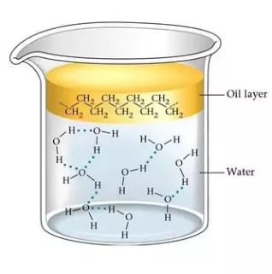
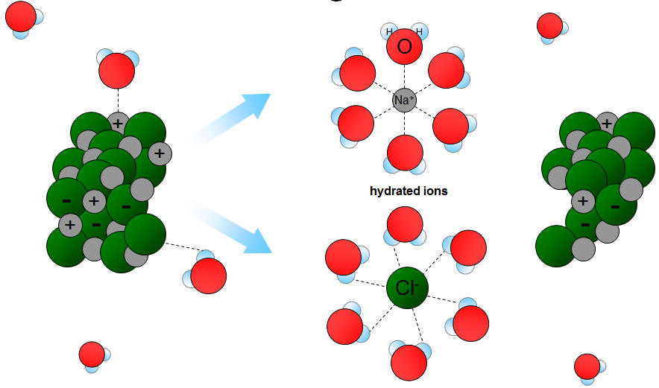
Like Attracts Like
These intermolecular forces play an incredibly significant role in intermolecular interactions (particularly when looking at polar and non-polar molecules)
Notes:
Water not dissolving a stain? Try something non-polar!

Slide 19
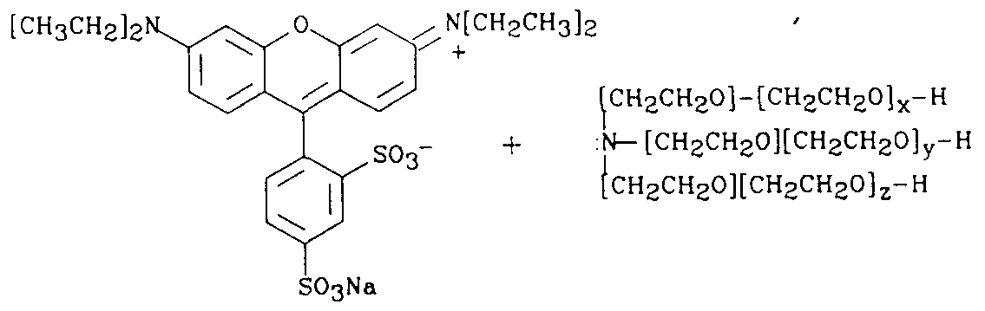
Like Dissolves Like
This is why I use hand sanitiser to help dissolve the whiteboard markers

Slide 20
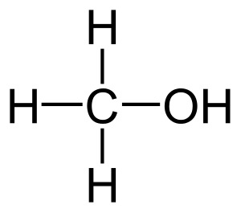
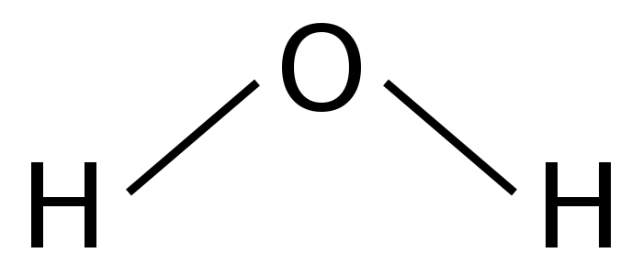
Like Dissolves Like
This is why acetone/methylated spirits can dissolve permanent markers, but water cannot

Slide 21
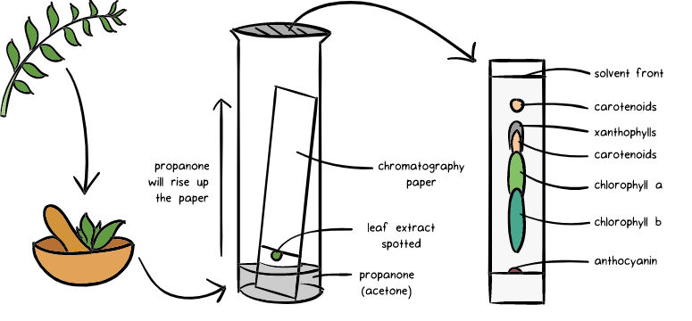
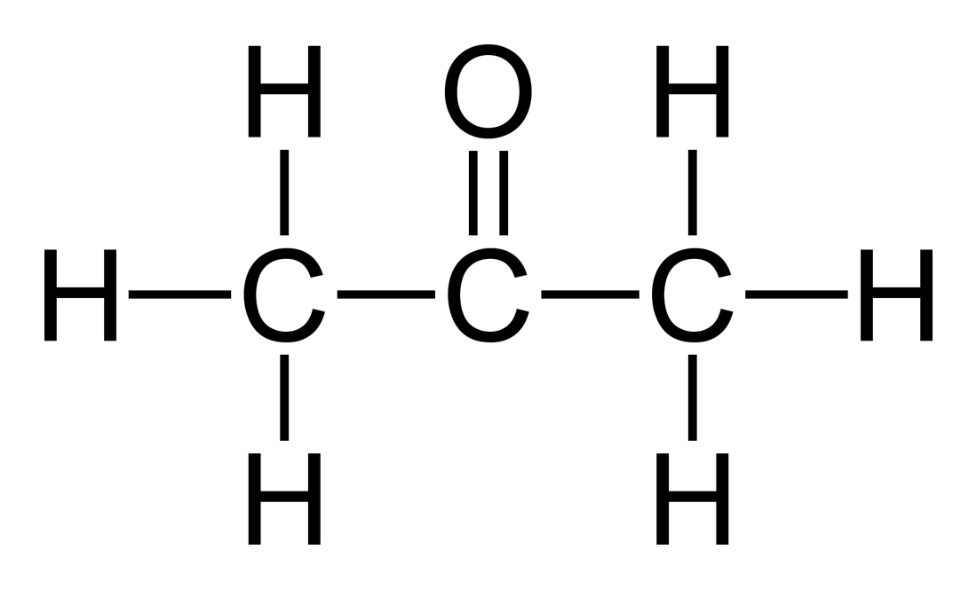
Acetone

Slide 22
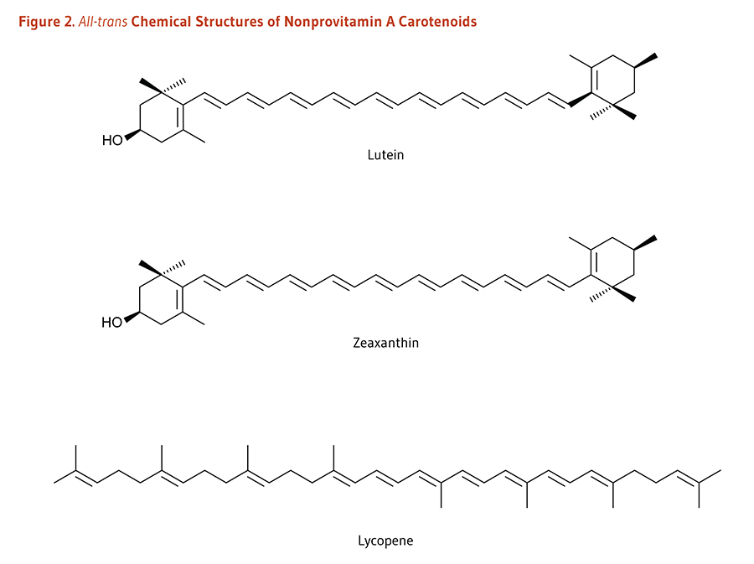

Slide 23
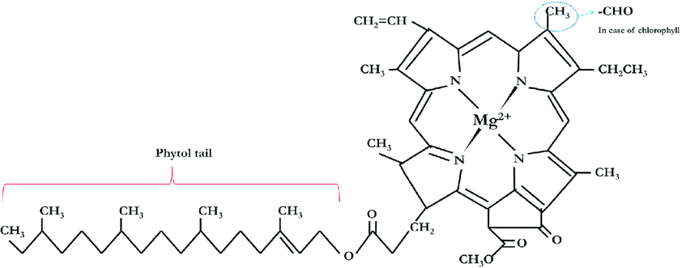
Chlorophyll

Slide 24
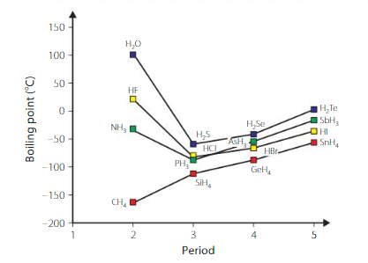
Hydrogen Bonding

Slide 25
Your turn
Name the type(s) of intermolecular forces that exist between molecules in each of the following substances:
HBr
CBr₄
H₂
CH₃OH
Ask:
Does it have dispersion forces?
Is it polar?
Does it have dipole – dipole forces?
Is H involved? Are Hydrogens bonded to N, O or F?
Are there lone electron pairs?

Slide 26
Name the type(s) of intermolecular forces that exist between molecules in each of the following substances:
HBr –
CBr₄ –
H₂ –
CH₃OH -

